Slide 1
MVC: Javascript Framework

Slide 2
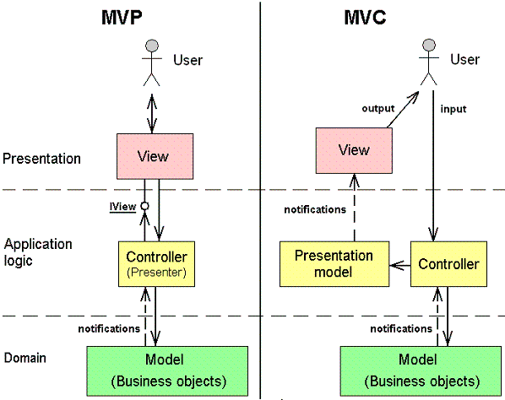
MVC/MVP Model

Slide 3
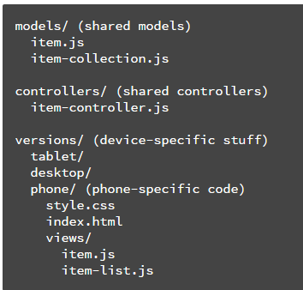
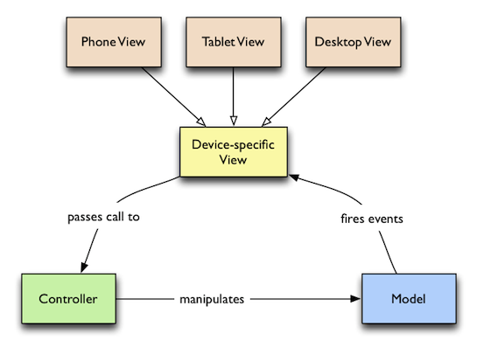
MVC Pattern
small screens + touch (mostly phones)
large screens + touch (mostly tablets)
large screens + keyboard/mouse (mostly desktops/laptops)
https://www.html5rocks.com/en/mobile/cross-device/

Slide 4
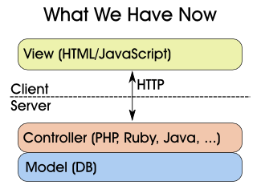
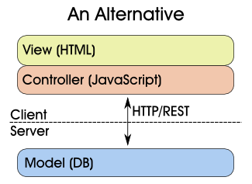
MVC Architecture
put the Controller on the client, and build a RESTful HTTP interface to communicate with the database.
https://stuartsierra.com/2008/07/07/moving-the-c-in-mvc

Slide 5
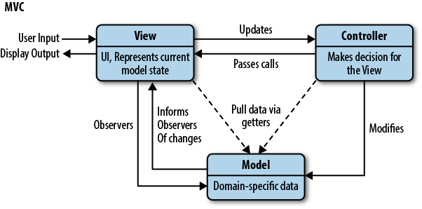
Javascript Design Pattern: MVC
https://www.safaribooksonline.com/library/view/learning-javascript-design/9781449334840/ch10s02.html

Slide 6
Javascript Framework
A number of frameworks boasting support for MVC (or the MV* family)
Allowing developers to easily add structure to their applications.
E.g., Backbone, Ember.js, and AngularJS.
https://www.safaribooksonline.com/library/view/learning-javascript-design/9781449334840/ch10s02.html

Slide 7
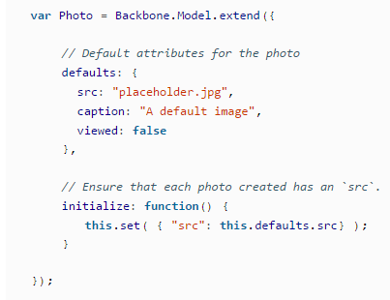
Model
In a photo gallery, the concept of a photo would merit its own model, as it represents a unique kind of domain-specific data.
manages the data for an application.
represent unique forms of data that an application may require.
When a model changes (e.g., when it is updated), it will typically notify its observers (e.g., views, a concept we will cover shortly) that a change has occurred so that they may react accordingly.
https://www.safaribooksonline.com/library/view/learning-javascript-design/9781449334840/ch10s02.html

Slide 8
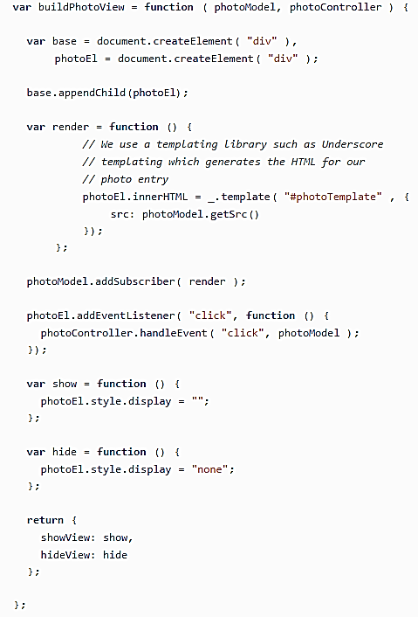
View
a visual representation of models that present a filtered view of their current state.
JavaScript views are about building and maintaining a DOM element.
A view typically observes a model and is notified when the model changes, allowing the view to update itself accordingly.
https://www.safaribooksonline.com/library/view/learning-javascript-design/9781449334840/ch10s02.html

Slide 9
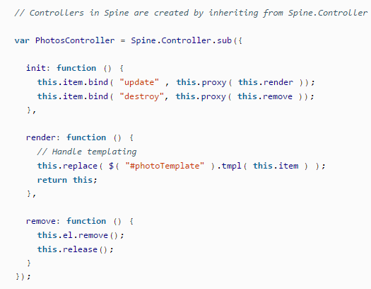
Controller
Intermediaries between models and views, which are classically responsible for updating the model when the user manipulates the view.
In our photo gallery application, a controller would be responsible for handling changes the user made to the edit view for a particular photo, updating a specific photo model when a user has finished editing.
https://www.safaribooksonline.com/library/view/learning-javascript-design/9781449334840/ch10s02.html

Slide 10
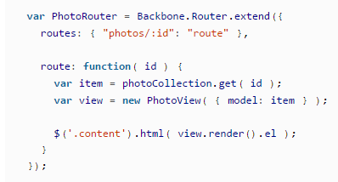
Backbone
In Backbone, Routers handle a little more of the controller responsibility, as it’s possible to bind the events there for models and have our view respond to DOM events and rendering.
In Backbone, one shares the responsibility of a controller with both Backbone.View and Backbone.Router. In Router, controllers manage the logic and coordination between models and views in an application.

Slide 11
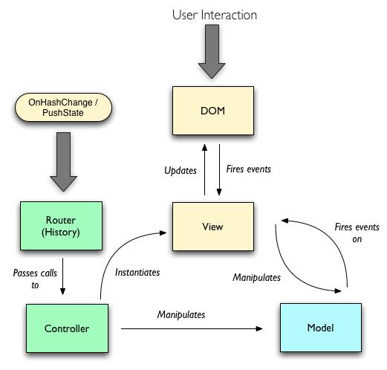
Backbone.js
One of the most popular javascript framework.
implementation of the traditional Model-View-Controller pattern.

Slide 12
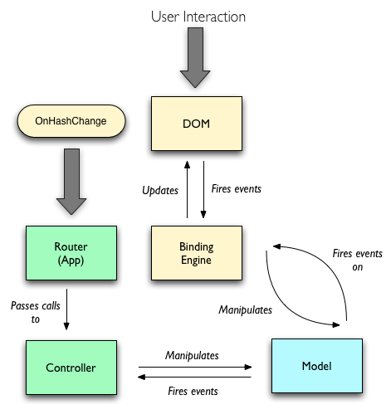
Batman.js
The presence of a strong data binding engine and pure HTML views suggests that it is actually an implementation of the Model-View-ViewModel.

Slide 13
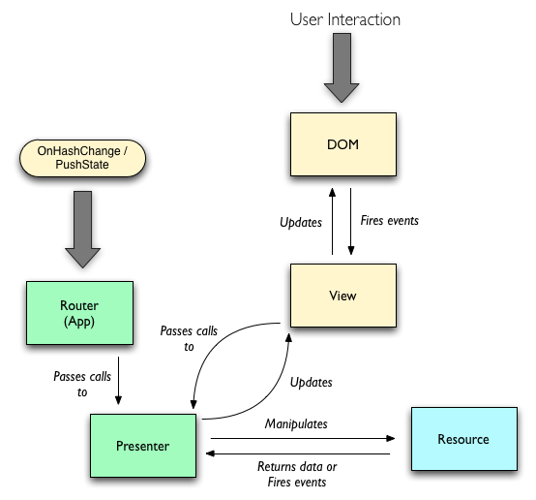
Client-side Resource-View-Presenter (RVP)
As with Backbone and Batman, Client-side RVP implementations should support both OnHashChange / pushState routing and DOM events.

Slide 14
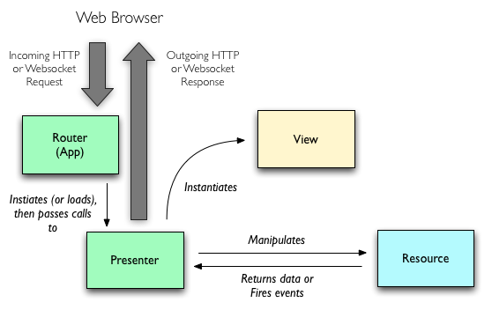
Server-side Resource-View-Presenter (RVP)
On the Server-side Resource-View-Presenter is almost identical with one notable exception: the View is ephemeral and does not pass calls or have a reference to the Presenter.

Slide 15
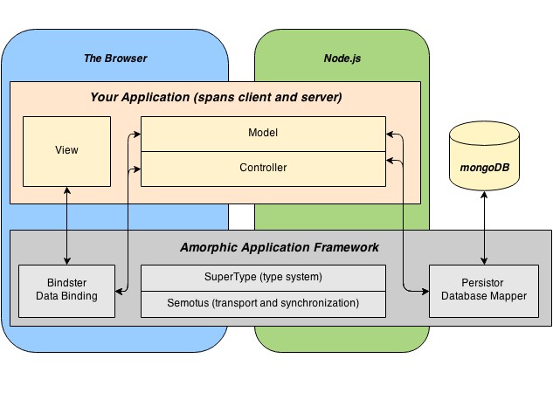
Amorphic Application Framework
It is based on JavaScript, Node.js and MongoDB in a way that lets us focus more on application logic and less on framework specifics.
http://elsamman.com/?p=117

Slide 16
Amorphic Application Framework
SuperType is a type system for building a model using classical inheritance, mix-ins and composition.
Bindster, connects your object model to your markup and functions as a bi-directional template.
Semotus synchronizes objects so you can make calls between browser and server transparently.
Persistor lets you serialized to and reconstruct objects from MongoDB.
Amorphic pulls it all together in support of a model, view, controller paradigm that spans browser and server.
http://elsamman.com/?p=117

Slide 17
Amorphic Application Framework
Minimal Structure – The only real structure imposed is that all objects must be defined via SuperType and that all objects to be transported and synchronized must hang off of the controller, directly or indirectly.
Single Page Apps- Because the state is always available on the server when you arrive on a new page your full state is preserved and you wake up where you left off.
Session Based – Amorphic is built with traditional applications in mind and so sessions are rigorously isolated with sharing achieved via the database. Amorphic is built on XHR calls though a socket IO pub/sub will eventually be layered on top for applications that need real-time channels.
Security– Because Amorphic is a new paradigm that is not based on form posts or RESTful. In the meantime, Amorphic itself has the building blocks needed to write a secure application.
http://elsamman.com/?p=117

